Slide 1

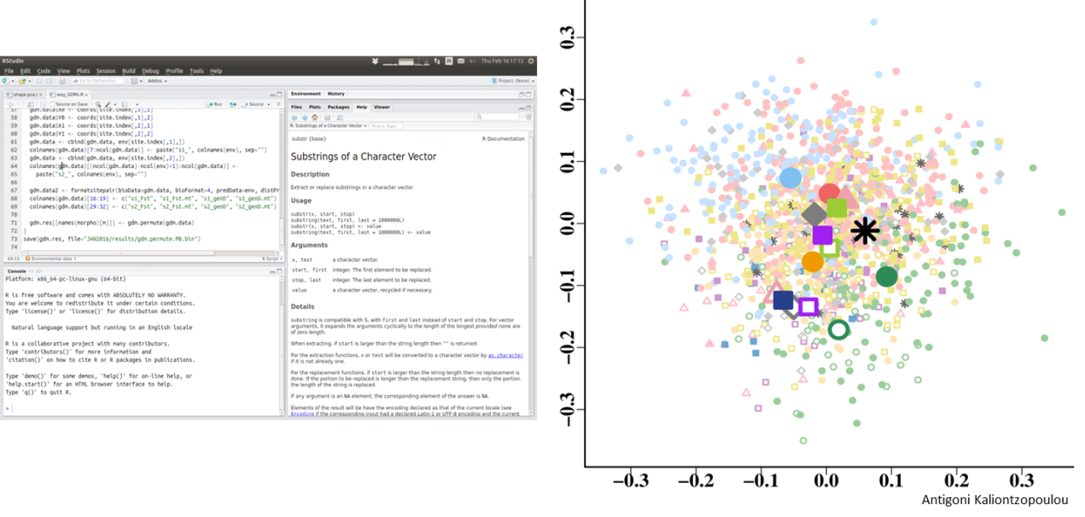
ADVANCED COURSE
INTRODUCTION TO R
FUNCTIONS AND PACKAGES
Antigoni Kaliontzopoulou
4 - 8 November 2019| CIBIO-InBIO, Vairão, Portugal

Slide 2
Everything that exists is an object
Everything that happens is a function call
- John Chambers

Slide 3
Everything you do in R is organized into functions
Functions are pieces of code, intended to fulfill... a function!
Objective: code abstraction and shortening. When using a function, you do not need to see all of its code (but you may want to see the related documentation, see further on)
They can be thought of as recipes for operations you repeat a lot
e.g. Imagine you always want to add three numbers and divide by three
This would be much faster to repeat if we turned it into a function
> x <- 15 > y <- 23 > z <- 36 > sum.all <- x + y + z > sum.div.3 <- sum.all/3 > sum.div.3 [1] 24.66667
> sum.div.3 <- function(x, y, z) {
+ sum.all <- x + y + z
+ sum.div.3 <- sum.all/3
+ return(sum.div.3)
+ }
sum.div.3(15, 23, 36)

Slide 4
We can write our own functions (see end of the week)
Mostly we use built-in R functions
These are downloaded from CRAN (see packages further on)
Functions are objects on their own right
But functions and objects are different things
When calling a function as an object, we see its content. In some cases we can see the associated code, in others the code is “hidden”
IMPORTANT NOTICE: using built-in function names to name objects can cause you important trouble!!!

Slide 5
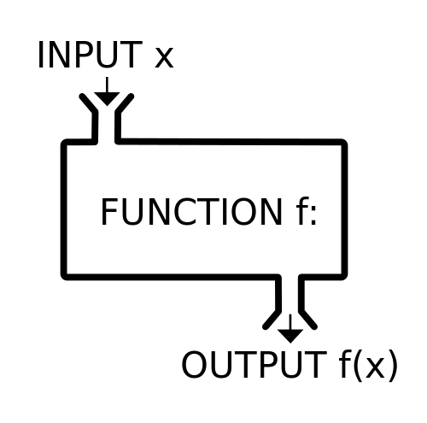
The object(s) that we want to “manipulate”
(and maybe some conditions on how to do it)
ARGUMENT(S)
The “recipe” of what we want to do
The code of the function
FUNCTION OBJECT
The result of implementing the function f on object x, with the defined arguments

Slide 6
Various types of functions
In terms of origin (i.e. built-in, user-defined, from packages)
Arithmetic, statistical, plotting etc
Informative about objects
Informative about our workspace or system
Primitive functions, are functions that directly call C code, and they have no underlying R code associated
Once the function is applied, the result is shown in our screen, but it is not stored
You need to store function results into a new object
Functions can be nested one inside the other
In long series of nested functions, always read “inside-out”

Slide 7
Function arguments
Can be defined by position (in order)
by complete name (e.g. method = A)
by partial name (e.g. meth = A)
Some arguments have default values
Be VERY careful with defaults:
when you do not set an argument, you will be using the default
… is a special argument that allows us to pass arguments not passed to the function used, but used inside it through other functions
(see e.g. arguments from par() passed to plot(), Wednesday)
> mean(1:100, 0.025, T) [1] 50.5 > mean(x = 1:100, trim = 0.025, na.rm = T) [1] 50.5 > mean(x = 1:100, t = 0.025, n= T) [1] 50.5

Slide 8
Mostly (at least at the beginning) you will use built-in functions
Functions are organized in PACKAGES
There is a huge series of packages, for the full list see:
https://cran.r-project.org/web/packages/
To use a package, you need to:
Install it (only once, unless you update R)
Load it (in each session that you need it)
A useful command: installed.packages()
> install.packages(“vegan”)
> library(“vegan”)

Slide 9
Getting help:
?function_name (e.g. ?mean)
?package_name (e.g. ?vegan)
Search in the “help” tab of Rstudio
??some_useful_term
Function help pages may contain
Description: verbiage on what the function does
Usage: how the function is used (argument order and defaults, see next)
Arguments: description of the arguments
Details: more relevant info on argument options
Value: description of the returned object (class, content etc)
References
See also: other relevant functions (similar, related, complementary etc.)
Examples
Exact match
Fuzzy matching, more flexible,
depends on installed packages

Slide 10
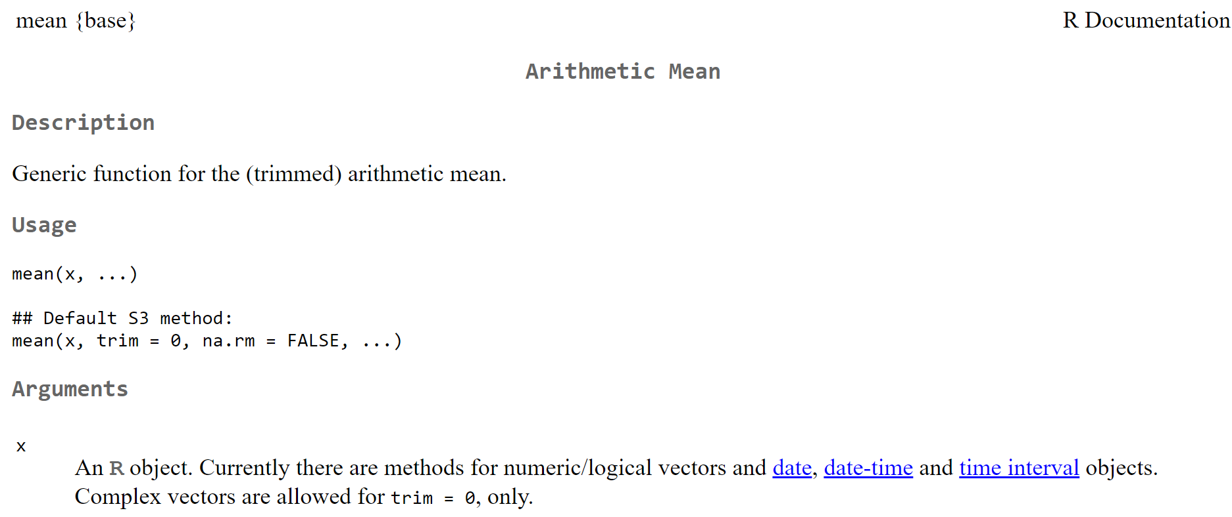
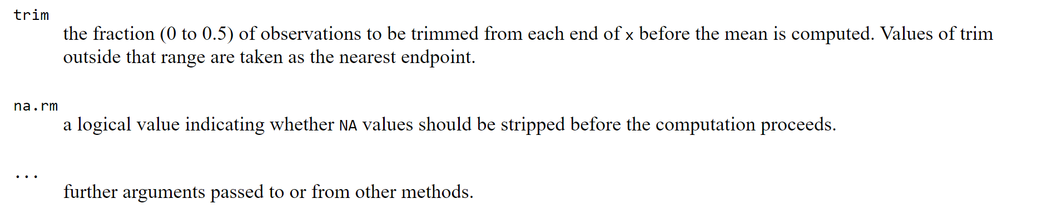
Package in which the function belongs

Slide 11
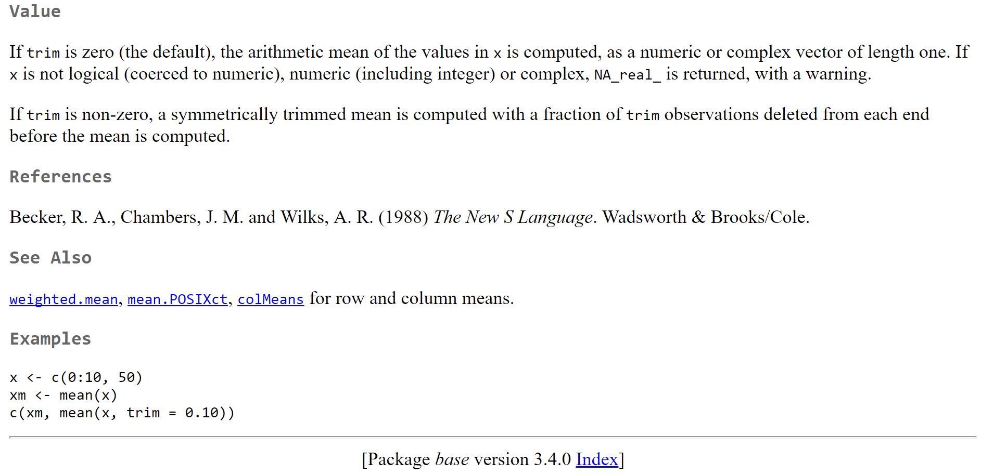

Slide 12
Why should WE care?
R includes endless packages
Basically, any biological data analysis you might think about can be done in R
https://cran.r-project.org/web/packages/available_packages_by_name.html
Many basic, general purpose analyses are implemented in packages base and stats, which are available by default with any R installation
base: https://stat.ethz.ch/R-manual/R-devel/library/base/html/00Index.html
stats: https://stat.ethz.ch/R-manual/R-devel/library/stats/html/00Index.html

Slide 13
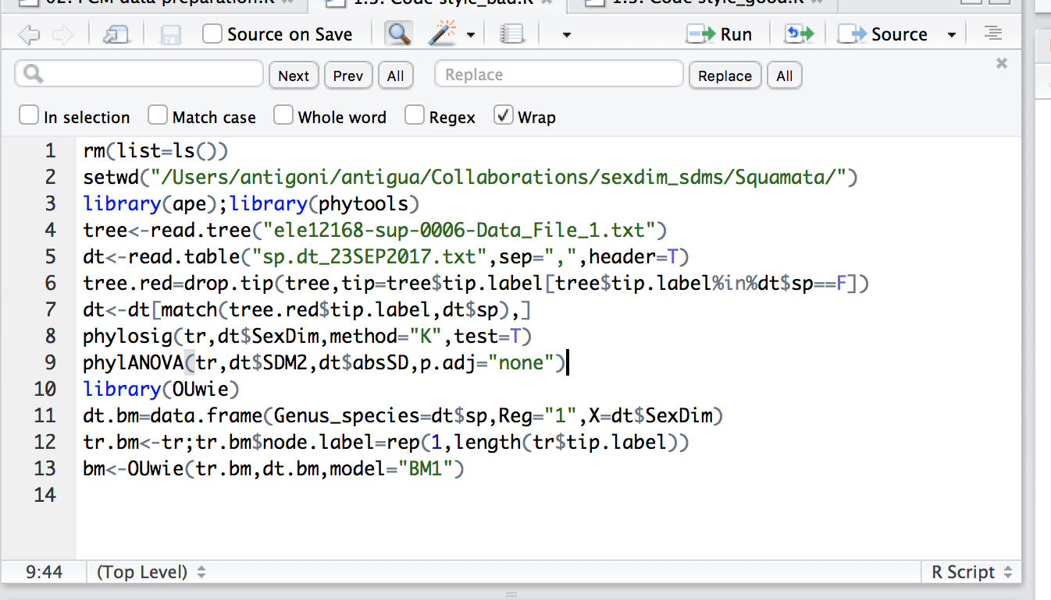
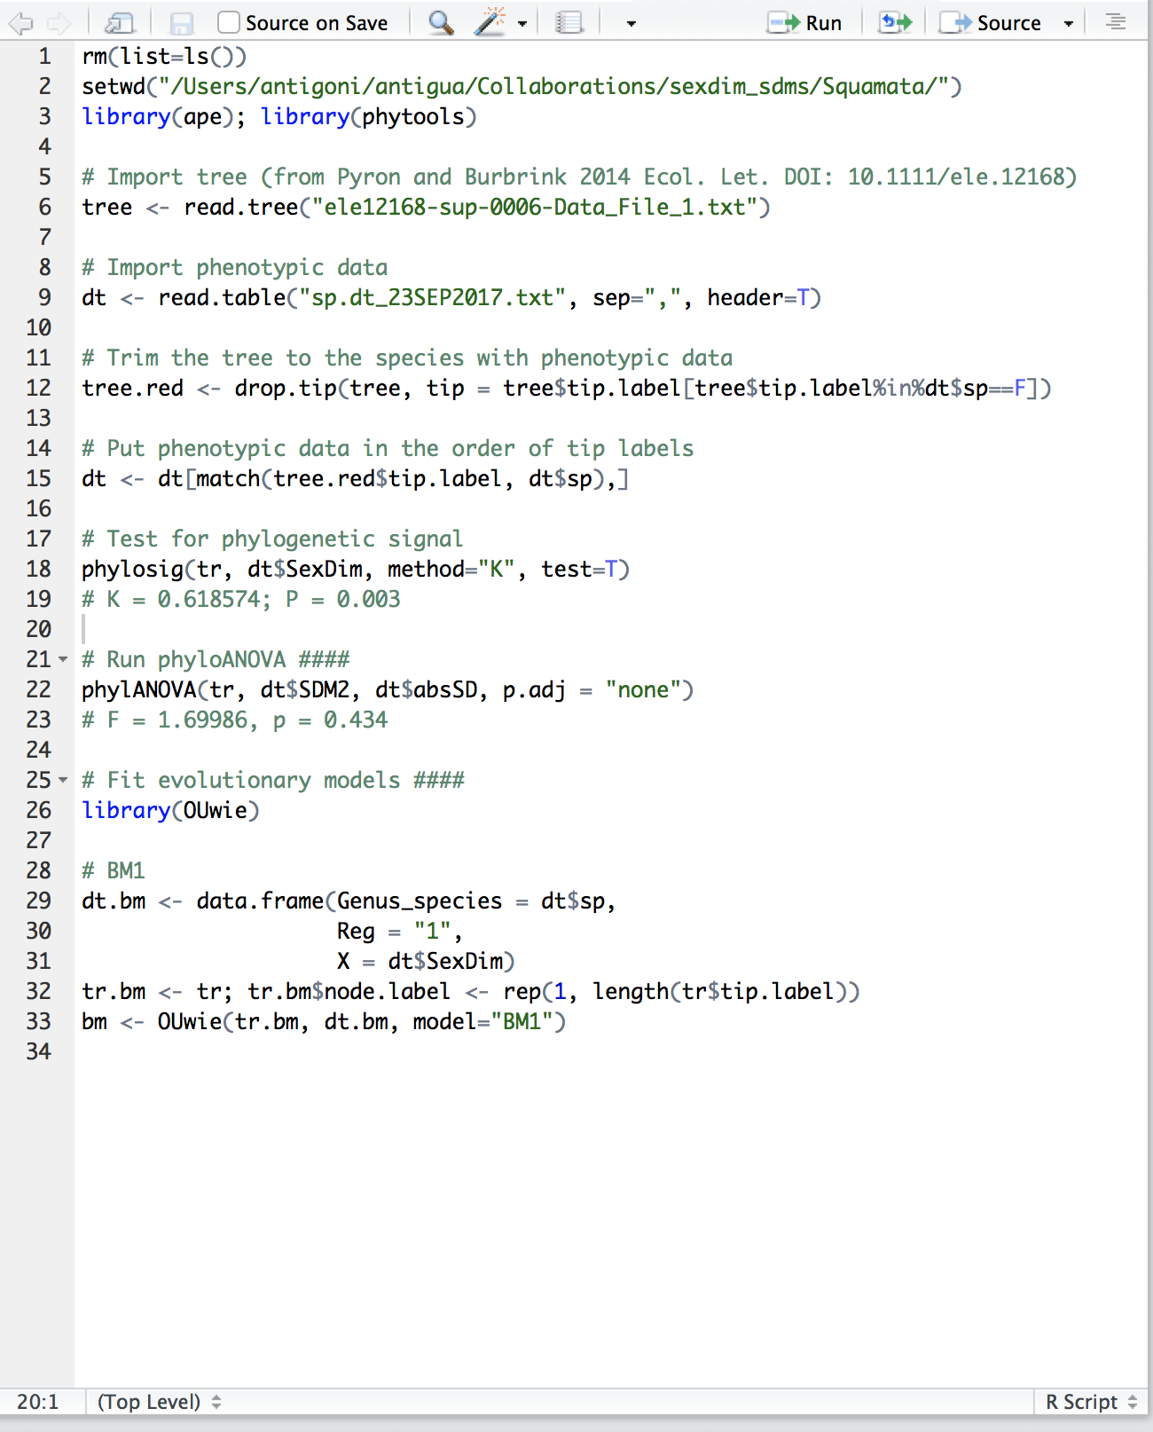
Typically, we use a series of functions to perform everyday operations with our data
It is VERY useful to adopt good code-writing practices from the beggining

Slide 14
Typically, we use a series of functions to perform everyday operations with our data
It is VERY useful to adopt good code-writing practices from the beggining
For you:
easier to remember what you did (and possibly why)
lighter on your brain
easier to debug
easier to modify
easier to translate into the “Statistical analyses” section of your paper
For collaborators: good code style makes it easier to share and interchange ideas
For reviewers: nowadays many top-rank journals require the R-code for review during article submission

Slide 15
Google's R Style Guide - https://google.github.io/styleguide/Rguide.xml
The goal of the R Programming Style Guide is to make our R code easier to read, share, and verify.

Slide 16
File Names
File names should end in .R and, of course, be meaningful. GOOD: predict_ad_revenue.R BAD: foo.R
Identifiers
Don't use underscores ( _ ) or hyphens ( - )
The preferred form for variable names is all lower case letters and words separated with dots (variable.name), but variableName is also accepted
GOOD: avg.clicks OK: avgClicks BAD: avg_Clicks
function names have initial capital letters and no dots (FunctionName)
GOOD: CalculateAvgClicks BAD: calculate_avg_clicks , calculateAvgClicks
constants are named like functions but with an initial k
kConstantName

Slide 17
Syntax
Keep maximum line length to 80 characters (avoid very long lines)
When indenting your code, use two spaces. Never use tabs or mix tabs and spaces
Place spaces around all binary operators (=, +, -, <-, etc.)
Do not place a space before a comma, but always place one after a comma
Extra spacing (i.e., more than one space in a row) is okay if it improves alignment of equals signs or arrows (<-)
Assignment
use ”<-”, not ”=“, for assignment
GOOD: x <- 5
BAD: x = 5
EVEN WORSE:
x=5

Slide 18
Braces
an opening curly brace should never go on its own line
a closing curly brace should always go on its own line
you may omit curly braces when a block consists of a single statement; however, you must consistently either use or not use curly braces for single statement blocks
always begin the body of a block on a new line.
GOOD:
if (is.null(ylim)) {
ylim <- c(0, 0.06)
}
or (but not both)
if (is.null(ylim))
ylim <- c(0, 0.06)
BAD: if (is.null(ylim)) ylim <- c(0, 0.06) if (is.null(ylim)) {ylim <- c(0, 0.06)}

Slide 19
Braces (continued)
surround else with braces
an else statement should always be surrounded on the same line by curly braces
GOOD:
if (condition) {
one or more lines
} else {
one or more lines
}
BAD:
if (condition) {
one or more lines
}
else {
one or more lines
}
BAD:
if (condition)
one line
else
one line

Slide 20
General Layout and Ordering
If everyone uses the same general ordering, we'll be able to read and understand each other's scripts faster and more easily.
Copyright statement comment
Author comment
File description comment, including purpose of program, inputs, and outputs
source() and library() statements
Function definitions
Executed statements, if applicable (e.g., print, plot)
Commenting Guidelines
Comment your code
Comment your code!
Comment your code!!
Comment your code!!!
Comment your code!!!!!!!!!!!!!!!
Entire commented lines should begin with # and one space
Short comments can be placed after code preceded by two spaces, #, and then one space
…and more ...
Google's R Style Guide - https://google.github.io/styleguide/Rguide.xml

